Slide 1
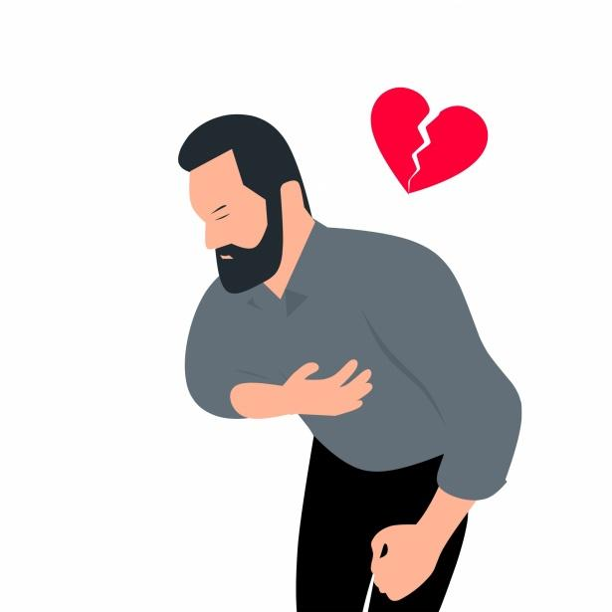
Project 4
Heart Disease Prediction
By: Jana Khamis , Paul Schaefer , King Yuet Lau(Janette) , Bhavesh Heetoo

Slide 2
Project Overview
Overview: We developed a machine learning-powered web application to predict an individual’s risk of heart disease based on key health indicators.
What was accomplished: Built and compared Neural Network, Random Forest, Decision Tree, and K-Nearest Neighbors models, selecting the Neural Network for its 100% accuracy.
Dataset: We used a heart disease dataset with features like age, blood pressure, cholesterol etc.
Outcome: The selected model was integrated into a Flask web app, allowing users to input health indicators and receive real time risk predictions.

Slide 3
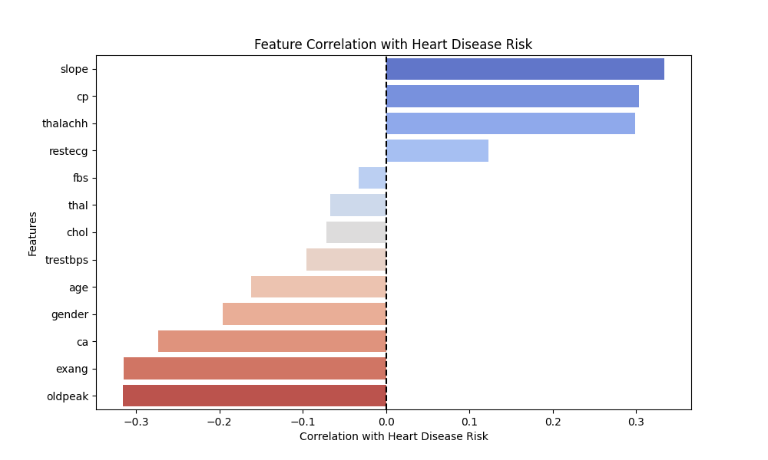
Which features are the most indicative of an individual having heart disease?

Slide 4
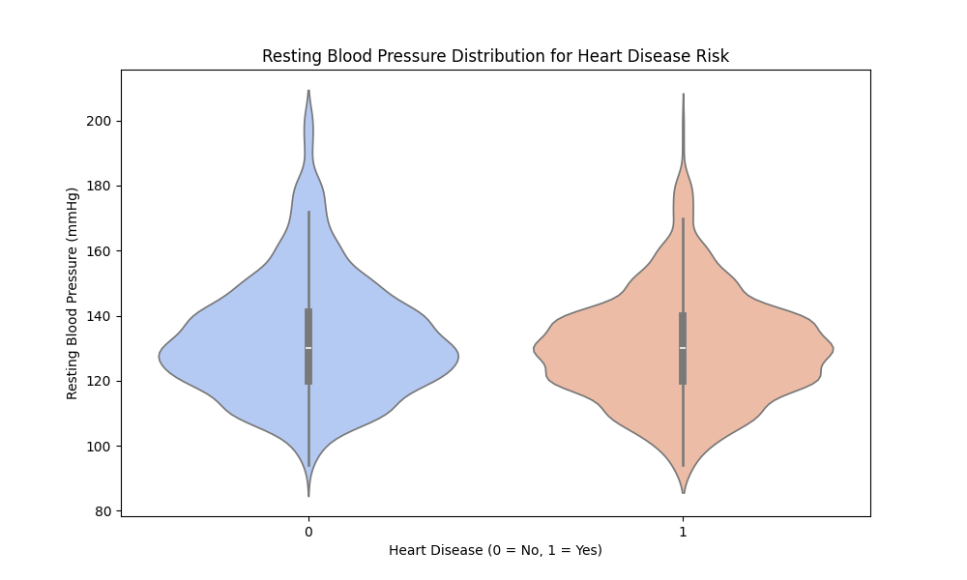
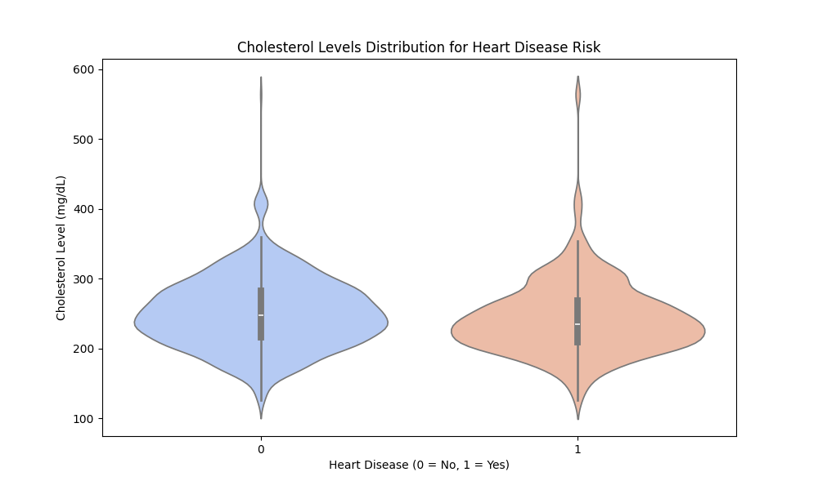
Are there threshold values for features like resting heart pressure or cholesterol levels that indicate a higher chance of having heart disease?

Slide 5
Machine Learning Models
Model | Accuracy
Neural Network (Deep Learning - Keras/TensorFlow) | 1.00 (100%)
Random Forest Classifier | 0.97 (97%)
Decision Tree Classifier | 0.96 (96%)
K-Nearest Neighbors | 0.95 (95%)

Slide 6
Neural Network Model (Layers)
Layer (type) | Output Shape | Param #
dense (Dense) | (None, 120) | 1,680
dense_1 (Dense) | (None, 60) | 7,260
dense_2 (Dense) | (None, 30) | 1,830
dense_3 (Dense) | (None, 1) | 31

Slide 7
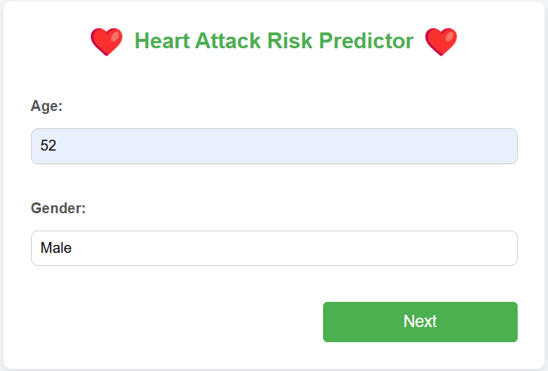
Web App
Developed a Flask powered web app for real time heart disease risk prediction. Users input key health indicators like age, blood pressure, etc.

Slide 8
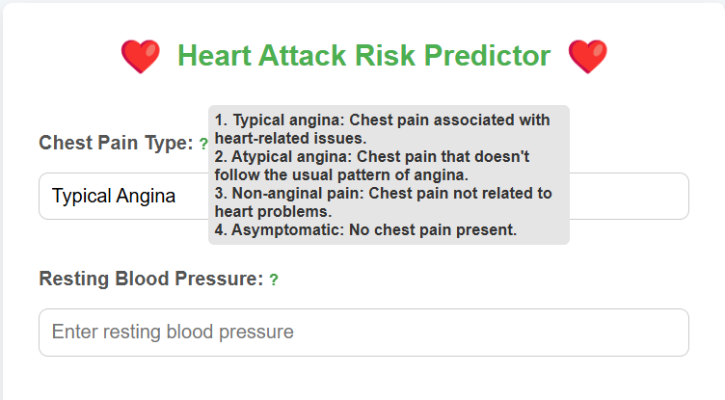
ToolTips
Tooltips provide the users with more information on the definitions and understand what to input.

Slide 9
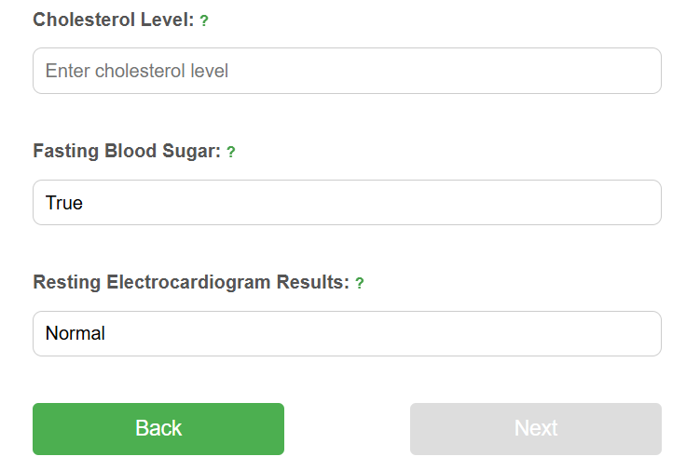
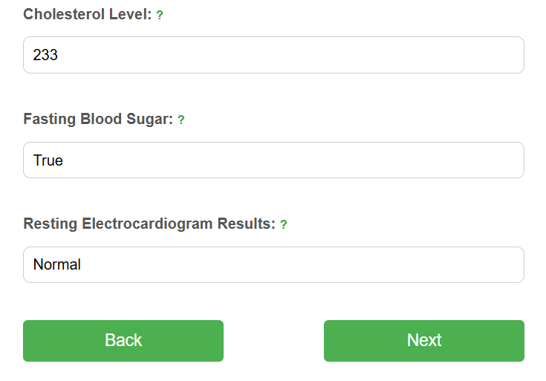
Button Activation

Slide 10
Conclusion
Accurate Prediction: Our Neural Network model achieved 100% accuracy, outperforming other models tested.
Value of our Web App: Helps users assess their risk of heart disease before symptoms appear, encouraging early detection and prevention.

